Slide 1
Lecture 3
Nick Rugai PhD

Slide 2
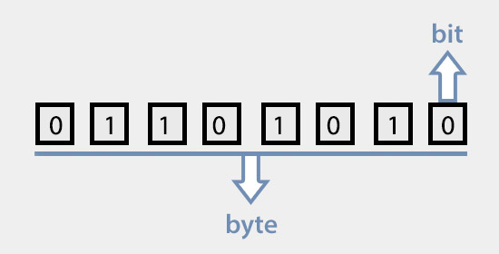
Variables
A variable is a memory location paired with a name.
A memory allocation is called byte.
Modern computer use 32 or 64 bits per byte.
A bit can be 1 or 0.
1000**1 kB kilobyte
1000**2 MB megabyte
1000**3 GB gigabyte
1000**4 TB terabyte
1000**5 PB petabyte
1000**6 EB exabyte
1000**7 ZB zettabyte
1000**8 YB yottabyte

Slide 3
Variables
A bit is the fundamental unit of computation.
Claude Shannon first use the term bit in 1928.
A bit is also called shannon:
One shannon is the information content of an event occurring when its probability is ​1⁄2.
A coin is a shannon.
The bit is the measure of information and entropy.
1-entropy=information.

Slide 4
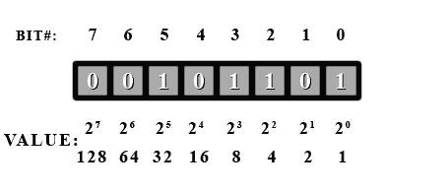
Variables
Classical byte has 8 bits.
128+64+32+16+8+4+2+1=255 for a 8 bit byte
What number is the example given?
B is short for byte.
b is short for bit.

Slide 5
Variables
100 in 8 bit byte=
99 in 8 bit byte=
1=
133=

Slide 6
Variables
Think of a variable as a name attached to a particular object. In Python, variables need not be declared or defined in advance, as is the case in many other programming languages. To create a variable, you just assign it a value and then start using it.

Slide 7
Variables
Assigning and naming a variable in Python:
>>> message = ‘Hello Wold’
>>> message
>>> n = 2
>>> n
>>> type(message)
>>> type(n)
In Python the value not the variable carries the type.

Slide 8
Variables names can be as long as you want.
Can be a mix and match of letters and numbers:
Can’t start with a number.
>>> 55bareels = ‘barrels’
Can’t use special characters or keywords:
False class finally is return none continue for lambda try true def from nonlocal while and del global not with as elif if or yield assert else import pass break except in raise
Standard to use lowercase.

Slide 9
Variables
Expression: >>> n + 2
>>> n =17 #Statement
>>> print (n) #Statement
>>> n #Statement
# sign allows to use comments.
Anything after the # sign is ignored.
Use lots of comments!!!

Slide 10
Operations
Operations Have an Order! PEMDAS
Parenthesis >>> (1+1) * (2+3)
Exponentiation >>> 1 + 2 **3 >>> 2*3**2
Multiplication >>> 2*3-5
Division >>> 10/5-2
Addition
Subtraction
Still use parenthesis to make it obvious

Slide 11
Operations
Operations on strings do not work:
>>> ‘2’-’1’
The + sign performs a string concatenation:
>>> first = ‘hello’
>>> second = ‘world’
>>> first + second
The * sign performs a repetition
>>> first*3

Slide 12
Memory Allocation
Python has a garbage collector for variables.
Garbage Collection allows to reclaim unused memory allocations.
In C, the programmer must reclaim them!
Garbage collection makes debugging easier but it is more time consuming.

Slide 13
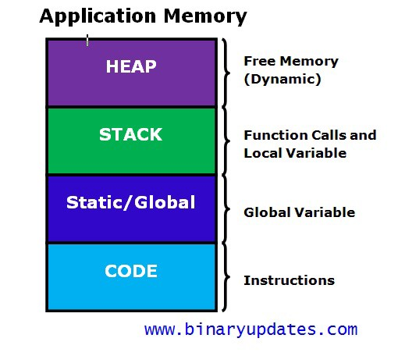
Memory Allocation
Stack is Static memory allocation
Heap is Dynamic
Python uses a Private Heap

Slide 14
Python Memory Management
Ensure that there is memory available.
Has strategies for sorting strings, ints, floats, etc.
Controlled by the interpreter not the user.
Treats memory as objects.
Automatic garbage collection.

